Slide 1

Chapter 570 - Uniform Reporting System for Prescription Drug Price Data Sets
2024 Requirements
March 14, 2024
3:00 – 4:00 pm EST

Slide 2
Participant Reminders
Please mute your audio.
Please submit questions via the webinar chat feature.
We will respond to questions in writing and make them available in the FAQ posted in the MHDO Prescription Drug Price Data Portal.
A recording of the webinar will be distributed after the webinar and made available on the MHDO website.

Slide 3
Agenda
  Welcome & Review of Agenda
  Review Maine Health Data Organization’s (MHDO) Mandate
  Review Requirements in 90-590 Chapter 570, Uniform Reporting System for Prescription Drug Price Data Sets
  Review Timeline Associated with Requirements in Chapter 570
  Demo of MHDO’s Prescription Drug Pricing Portal
  Review Resources
  Questions

Slide 4
The Maine Health Data Organization (MHDO) is required by Public Law 2019, Chapter 470, to collect pricing component data from prescription drug manufacturers, wholesale drug distributors and pharmacy benefit managers (reporting entities).
§8731. 4. “Pricing component data" means data unique to each manufacturer, wholesale drug distributor or pharmacy benefits manager subject to this subchapter that evidences the cost to each manufacturer, wholesale drug distributor or pharmacy benefits manager to make a prescription drug available to consumers and the payments received by each manufacturer, wholesale drug distributor or pharmacy benefits manager to make a prescription drug available to consumers, taking into account any price concessions, and that is measured uniformly among the entities, as determined by rules adopted by the organization pursuant to section 8737.

Slide 5
90-590 CMR Chapter 570: Uniform Reporting System for Prescription Drug Price Data Sets, is the MHDO rule that contains the provisions for filing pricing component data and includes:
  Identification of the organizations required to register and report;
  Establishment of requirements for the content, format, method, and time frame for filing prescription drug price data;
  Establishment of standards for the data reported; and
  Compliance provisions.

Slide 6
Confidentiality Provision in Chapter 570
  Section 6. Confidentiality
  Information provided to the MHDO as required by Chapter 570 by a manufacturer, wholesale drug distributor or pharmacy benefits manager is confidential and not a public record under Title 1, chapter 13, except that the MHDO may share information:
  A. Bureau of Insurance. With the Department of Professional and Financial Regulation, Bureau of Insurance, to the extent necessary for the bureau to enforce the provisions of Title 24-A, as long as prior notice is provided to reporting entities that information will be shared, and any information shared is kept confidential;
  B. Aggregate. In the aggregate, as long as it is not released in a manner that allows the determination of individual prescription drug pricing contract terms covering a manufacturer, wholesale drug distributor or pharmacy benefits manager; and
  C. Publicly Available. That is available, for purchase or otherwise, to the public
  NOTE: Data submissions through the MHDO portal are secure; data submissions through e-mail are not. Never send completed templates via e-mail.

Slide 7
Title 22, Chapter 1683, §8736. Public report. Beginning November 1, 2020 and annually thereafter, the organization shall produce and post on its publicly accessible website an annual report, including information developed from the disclosures received pursuant to this subchapter on trends in the cost of prescription drugs, analysis of manufacturer prices and price increases, the major components of prescription drug pricing along the supply chain and the impacts on insurance premiums and cost sharing and any other information the organization determines is relevant to providing greater consumer awareness of the factors contributing to the cost of prescription drugs in the State. The report may not make public any information that is confidential pursuant to section 8733. The organization shall submit the report required by this section to the joint standing committee of the Legislature having jurisdiction over health data reporting and prescription drug matters and the committee may report out legislation to the first regular or second regular session of the Legislature, depending on the year in which the report is submitted.

Slide 8

Registration Requirements
[c. 570 sec 2(A)]
Action required annually by January 30th: Review and update Summary and Users information via the MHDO Prescription Drug Price Data Portal.
If your organization was not previously registered or you need help with your user account, please contact the MHDO Help Desk (mhdohelp@hsri.org).

Slide 9
Registration Notes
Manufacturers that do not set the Wholesale Acquisition Cost (WAC) or for which no products are distributed in Maine are not subject to the requirements of Chapter 570 [Secs 1(G)].
Virtual manufacturers that are doing business in Maine must be registered in the MHDO portal as manufacturers, not wholesale drug distributors.

Slide 10
Registration Notes (2)
Wholesale drug distributors that do not distribute prescription drugs in Maine are not subject to the requirements of Chapter 570 [Secs 1(W)(ii)].
Pharmacy Benefits Managers that are not managing prescription drug coverage in Maine are not subject to the requirements of Chapter 570 [Sec 1(M)].

Slide 11
Registration Notes (3)
Additional entities not required to register and report under Chapter 570:
1. Manufacturers or distributors of medical convenience kits or medical equipment only;
2. Registered 503b outsourcing/compounding facilities;
3. Contract manufacturing only;
4. Manufacturers of unfinished drugs;
5. Manufacturers and distributors of medical oxygen/nitrogen/specialty gases only;
6. Manufacturers and distributors of prescriptions drugs that are for veterinary use only;
7. Charitable organizations;
8. Third-party logistics (3PLs) companies

Slide 12
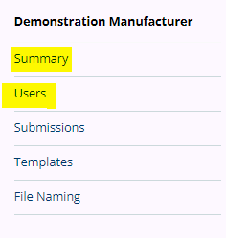
Chapter 570 Annual Registration
  Confirmation of company Summary information and company Users.
  User information is required for communications from the MHDO and should be updated as often as needed to maintain timely, focused communication.

Slide 13
MHDO Notifications
[c. 570 secs 2 (B) and 2(C)(1, 2)]
No later than January 30th of each year, the MHDO posts on its publicly accessible website NDCs that hit one of the triggers during the prior calendar year, as defined in 90-590 CMR Chapter 570.
On or before February 15th of each year, the MHDO produces and posts on its publicly accessible website a list of drug product families for which it intends to request pricing component data.
Not sooner than 30 days after publicly posting the list of drug product families, the MHDO notifies reporting entities via e-mail whether or not pricing component data is required.

Slide 14
Pricing Component Data
Requirements, Template Download, Completion &
Submission
[c. 570 secs 2(C)(3) and 2(D, E and G)]
If required, download pre-populated template(s) beginning March 18, 2024, from the MHDO Prescription Drug Price Data Portal.
Complete template(s) within your own environment.
Submit completed template(s) by May 17, 2024, via the MHDO Prescription Drug Price Data Portal. Never send completed templates via e-mail!

Slide 15

Timeline
Task Name | Date
MHDO Prescription Drug Price Data Portal 2024 registration must be completed | 1/30/24
The MHDO produces and posts on its publicly accessible website a list of prescription drugs for which the manufacturer has met any of the three criteria during the prior calendar year | 1/30/24
The MHDO produces and posts on its publicly available website a list of drug product families for which it intends to request pricing component data from manufacturers, wholesale drug distributors and pharmacy benefits managers | 2/16/24
MHDO's data vendor, HSRI, notifies manufacturers, wholesale distributers and PBMs via email that prepopulated Pricing Component Data templates, including specific NDCs for which reporting is required, are available for download from the MHDO Prescription Drug Price Data Portal | 3/18/24
Completed Pricing Component Data templates are due | 5/17/24

Slide 16
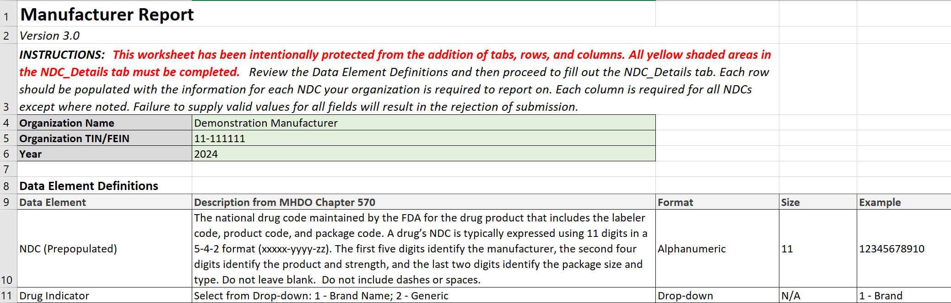
Pricing Component Data Templates
Pre-Populated Excel Templates

Slide 17
Criteria for NDC Inclusion
The criteria for inclusion on this year’s list are NDCs that are:
Calculated as a top 25 NDC that is most costly, most prescribed, or having the highest year over year increase (7/1/22 – 6/30/23)
a top 25 NDC with the highest average per member out of pocket cost (7/1/22 – 6/30/23)
Or
pharmaceutically equivalent with the same package size as an NDC described above

Slide 18
Data Quality –
Process Improvements
In previous years, the MHDO manually reviewed data submissions and coordinated with reporting entities to verify data values that did not fall within expected parameters or where data corrections were required.
Beginning in 2024, the MHDO and its data vendor, HSRI, will implement process improvements to provide earlier data quality feedback to reporting entities through scheduled, automated data validation processes.

Slide 19
Data Quality –
Common Issues
Validation Issue | Solution
Invalid template | Please wait until March 15th for the release of the new template. Do not update and resubmit a template from a prior year.
Data values are not provided for one or more NDCs in the template received. | Please resubmit an updated template containing values for all NDCs. Do not delete records or fields. If values are not applicable for a data element, enter 0.
All financial values are duplicated across multiple records. | Data should be provided specific to each NDC individually.
Data values are not provided for one or more NDCs, for one or more columns. | Provide missing values in the specified fields. If values are not applicable for a data element, enter 0.

Slide 20
Data Quality –
Common Issues
Validation Warning | Solution
Pharmacy reimbursement values are greater than payment receivable values for one or more NDCs. Pharmacy reimbursement values are significantly lower than WAC when evaluated per pricing unit administered for one or more NDCs. Rebate payable values are greater than rebate receivable values for one or more NDCs. Rebate payable values are greater than payment receivable values for one or more NDCs. Rebate receivable values are greater than acquisition cost values for one or more NDCs. | Validation warnings are intended to alert reporting entities to potential data issues. In all cases, financial values should reflect amounts accrued during the reporting period whether or not payment was actually made or received.

Slide 21
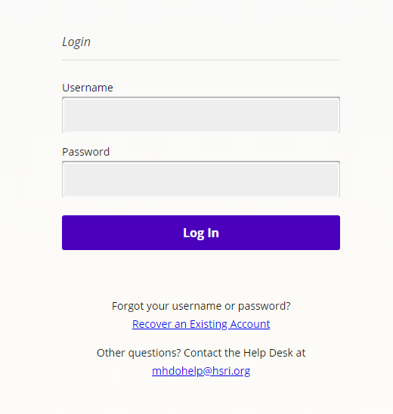
MHDO Prescription Drug Price Data Portal Demo

Slide 22
Enforcement Provisions Ch. 570, Section 4(D)
  Enforcement. The failure to file, report, or correct prescription drug price data sets when required in accordance with the provisions of this Chapter may be considered a civil violation under 22 M.R.S. § 8705-A and Code of Maine Rules 90-590, Chapter 100: Enforcement Procedures.

Slide 23
Resources
MHDO website: MHDO Home Page (maine.gov)
  MHDO Rules and Statutes (maine.gov)
  Trigger NDCs (maine.gov)
  List of Drug Product Families (maine.gov)
  Pricing Component Data (maine.gov)
  MHDO Prescription Drug Price Portal - Log In (maine.gov)

Slide 24
Technical Support
The MHDO Help Desk is available for any technical/system issue you may encounter in the MHDO Prescription Drug Price Data Portal. Key information:
    Hours of Operation (8 a.m. – 5 p.m. ET, Monday – Friday).
    Toll-free Phone: (866) 451-5876
    Email: mhdohelp@hsri.org
    You will receive a call back from the Help Desk or an e-mail follow-up within two hours of the request. Please include the organization name and U.S. Tax ID associated with the issue or request in all communications with the Help Desk.
Compliance and Assessments: Questions related to requirements for registration and data submissions, extension requests, and assessments should be directed to:
Philippe Bonneau, Ph.D.
Compliance Officer
Maine Health Data Organization
151 Capitol Street, 102 SHS
Augusta, ME 04333-0102
philippe.bonneau@maine.gov

Slide 25
Questions
Please submit questions via the webinar chat feature.
We will respond to questions in writing and make them available in the FAQ posted in the MHDO Prescription Drug Price Data Portal.

